Slide 1
JAR and libraries
Pavel Vrublevskij

Slide 2
Agenda
Introduction to libraries
Create library
Use created library
Make program executable

Slide 3
Agenda
Introduction to libraries
Create library
Use created library
Make program executable

Slide 4
Understanding Java Library (1/2)
According to WIKI:
The Java Class Library (JCL) is a set of dynamically loadable libraries that Java applications can call at run time.
The standard java library consists of a number of packages. Each package in turn consists of a number of classes (that provide similar functionality).
Most Widely Used Core Java Packages & Internal Libraries
These are the java libraries that are bundled with JDK and used for almost any application developed in java.

Slide 5
Understanding Java Library (2/2)
Java.lang
The java.lang package contains the classes and interfaces that are fundamental to the core Java language.
Java.util
This library provides users with generic java utilities like collections framework, formatted printing and scanning, array manipulation utilities, event model, date and time facilities, internationalization and miscellaneous utility classes
Java.io
This library is very useful and contains the classes that handle fundamental input and output operations in Java
Java.net
The package java.net contains classes and interfaces that provide a powerful infrastructure for networking in Java
Java.security
This package has several classes that allow users to encrypt a file using a user-provided key. It supports a cryptograph and digital signature.
Java.sql
It contains all the SQL related classes and interfaces. This package provides the API for accessing and processing data stored in a data source
Java.swing
The UI library for developing desktop Java applications.

Slide 6
45+ Most Useful Java Libraries (2014)
There are hundreds of Java libraries available today that cover every type of programming problem a Java developer is likely to come across. This article will take a look at Java libraries (core java and third party) every Java developer should know about before they write their first piece of code. Unfortunately, you will not find any of below mentioned third party libraries in java books since they are mostly project and requirements specific.
http://www.fromdev.com/2014/10/most-widely-used-java-libraries.html

Slide 7
Task
Create simple application
Find log4j library and include into your application
Every libraries has documentations, examples. Find one and use on your application.
Compile till success

Slide 8
Agenda
Introduction to libraries
Create library
Use created library
Make program executable

Slide 9
My Simple Library
Let‘s create simple class
package lt.codeacademy.week8.libraries.utils; public class MyUtils { private int sum; public int addTwoValue(int a, int b){ sum = a + b; return sum; } public void showSumOfTwoValues(){ System.out.println("SUM of two values is " + sum); } }

Slide 10
My Simple Library
Leave main method empty
package lt.codeacademy.week8.libraries; public class Main { public static void main(String[] args) { // Nothing here } }

Slide 11
My Simple Library
Goto Menu->File->Project Structure
On left panel side choose Artifacts

Slide 12
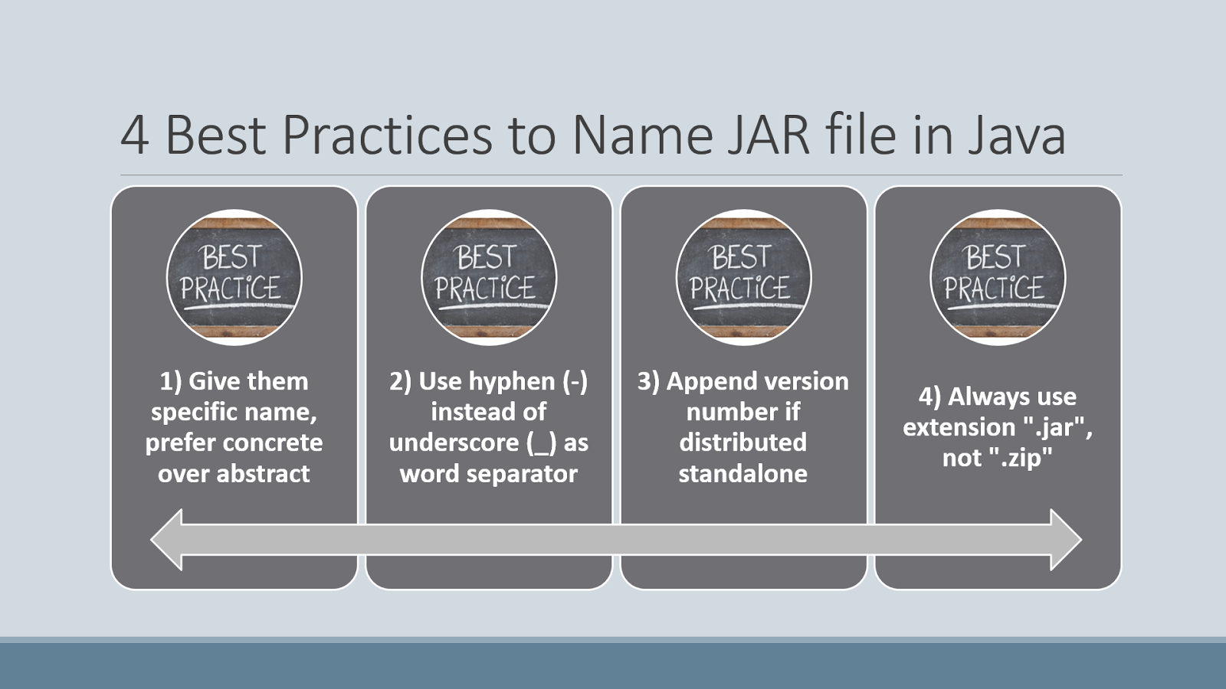

Slide 13
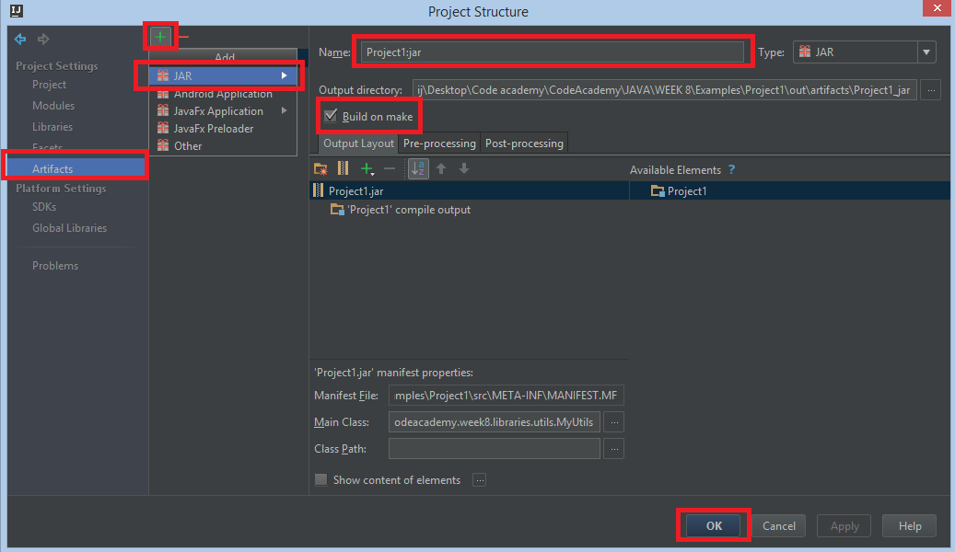
My Simple Library

Slide 14
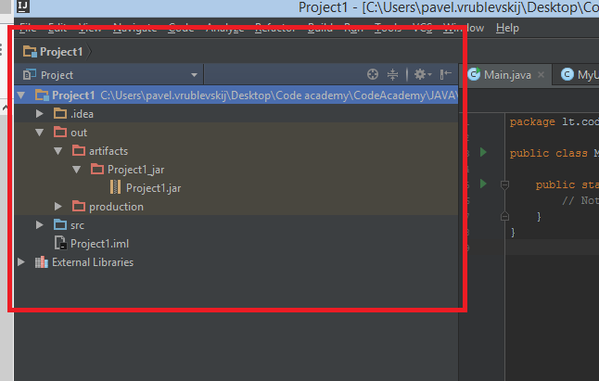
My Simple Library
jar file created

Slide 15
Agenda
Introduction to libraries
Create library
Use created library
Make program executable

Slide 16
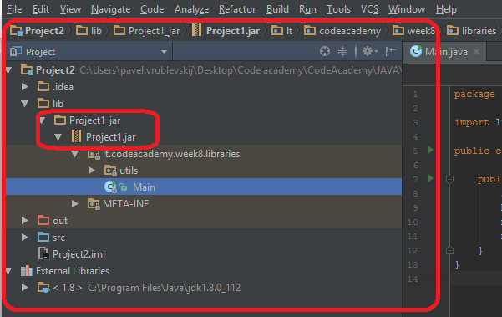
Using Library
Create simple project (another one)
Copy earlier created library into lib directory (create lib directory)
Example:

Slide 17
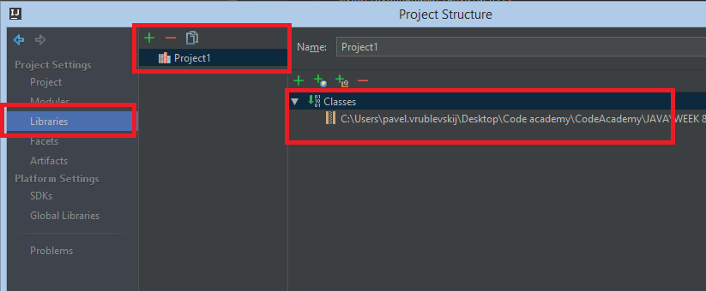
Using Library
Import Classes of your library. Goto Menu->File->Project Structure
On left panel side choose Libraries

Slide 18
Using Library
Import your library
Use library using objects (if none static)
Compile and see result
import lt.codeacademy.week8.libraries.utils.*;
System.out.println("I will call my created library methods"); MyUtils myUtils = new MyUtils(); myUtils.addTwoValue(1, 5); myUtils.showSumOfTwoValues();

Slide 19
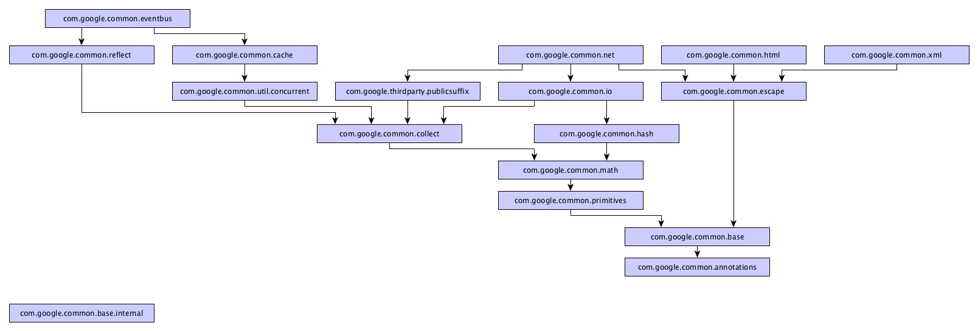
Library dependencies

Slide 20
Agenda
Introduction to libraries
Create library
Use created library
Make program executable

Slide 21
In Java, it is common to combine several classes in one .jar ("java archive") file. Library classes are stored that way. Larger projects use jar files. You can create your own jar file combining several classes, too.
jar files are created using the jar.exe utility program from the JDK. You can make your jar file runnable by telling jar.exe which class has main. To do that, you need to create a manifest file. A manifest is a one-line text file with a "Main-Class" directive. For example:
Main-Class: Craps
https://www.excelsior-usa.com/articles/java-to-exe.html
http://www.skylit.com/javamethods/faqs/createjar.html

Slide 22
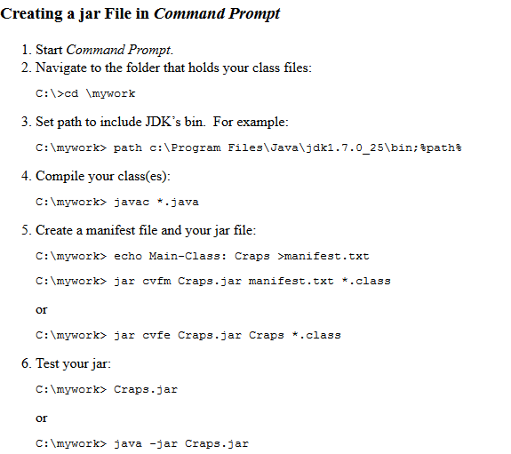
OR try via link
https://www.youtube.com/watch?v=vmiUecnDbh4

Slide 23
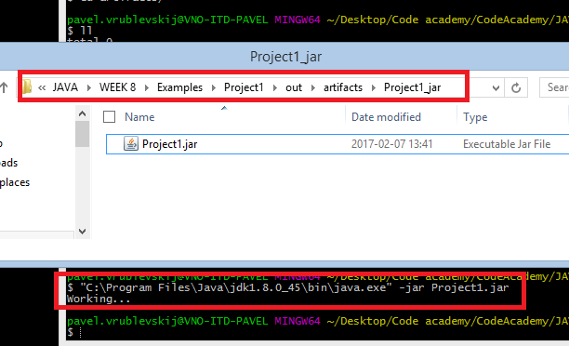
Run via command line

Slide 24
run.bat (Windows) or run.sh (Linux)
Bat
@echo off
"C:\Program Files\Java\jdk1.8.0_45\bin\java.exe" -jar Project2.jar
pause
Bash
#!/bin/bash
"$JAVA_HOME"/bin/java -jar /root/umar/bin/umar.jar

Slide 25
Task
Create your artifact as Maven or Gradle project
Use that artifact as dependency on parent project

Slide 26
Links
https://www.excelsior-usa.com/articles/java-to-exe.html
https://www.youtube.com/watch?v=vmiUecnDbh4
http://www.skylit.com/javamethods/faqs/createjar.html

